Slide 1
tutti
A8: Interactive High-fi Prototype
November 23, 2024
Stanford University

Slide 2




Jennifer Lew (’26)
Computer Science (AI)
Palos Verdes, CA
Alex Yansouni (’26)
Computer Science (HCI)
Los Altos, CA
Meghana Paturu (’26)
Computer Science (HCI) & Economics Belle Mead, NJ
Jonah Blaydes-Greenberg (’26)
Computer Science (AI) & Music Los Altos, CA

Slide 3
Overview
Problem
Solution
Students struggle to find quick academic support that ensures productive and impactful learning sessions
Students looking to gain teaching experience and earn extra income lack a platform to connect with potential tutees
A free marketplace where students can efficiently search for an available tutor and leverage AI to enhance learning experience

Slide 4
Value proposition
On demand tutoring you can trust

Slide 5
Agenda
Heuristic evaluation results
UI revisions
Prototype implementation status
Demo

Slide 6
Heuristic Evaluation Results

Slide 7
High Level Heuristics
93 Heuristic Violation
36 Level 3 and 4 Violations
Most violations on:
H4: Consistency & Standards
“Most of the issues are cosmetic or very minor.”

Slide 8
Quantitative Summary
Heuristic | # Viol. (sev 0) | # Viol. (sev 1) | # Viol. (sev 2) | # Viol. (sev 3) | # Viol. (sev 4) | # Viol. (total)
H1: Visibility of System Status | 0 | 3 | 1 | 1 | 2 | 7
H2: Match b/w System & World | 0 | 5 | 3 | 1 | 0 | 9
H3: User Control & Freedom | 0 | 0 | 2 | 3 | 2 | 7
H4: Consistency & Standards | 0 | 7 | 3 | 0 | 3 | 13
H5: Error Prevention | 1 | 0 | 2 | 5 | 2 | 9
H6: Recognition not Recall | 0 | 2 | 0 | 3 | 1 | 6
H7: Flexibility & Efficiency of Use | 0 | 1 | 2 | 2 | 3 | 8
H8: Aesthetic & Minimalist Design | 0 | 8 | 1 | 0 | 0 | 9
H9: Help Users with Errors | 0 | 1 | 0 | 1 | 1 | 3
H10: Help & Documentation | 0 | 2 | 5 | 1 | 0 | 8
H11: Accessible Design | 0 | 1 | 5 | 1 | 1 | 8
H12. ​​Value Alignment & Inclusion | 0 | 1 | 2 | 3 | 0 | 6
Total Violations | 1 | 31 | 26 | 21 | 15 | 93

Slide 9
Qualitative Summary
Visual Design and Aesthetics
Buttons lack visual consistency
Need for varied colors to highlight key actions
Use borders/Dividers to break up sections
Accessibility
Add clickable info bubbles to explain steps
Improve error message for required text entry
Ensure higher contrast for text for readability
Functionality
Add a menu for viewing/editing requests
New shortcut for repeating sessions
Adjust “Search Tutors” flow
Education Theme
Add student-friendly design elements
Use new Icons to brighten the interface
New education-focused theme

Slide 10
High Severity Violations (Level 4)
H4: Show Meeting Location
Display meeting locations on session request and acceptance
H5: Prevent Back After Payment
Disable back navigation after payment
H5: Add Edit/Cancel for Sessions
Allow users to confirm, edit, or cancel scheduled sessions
H7: Streamline Search
Enable tutor search directly on the home page.
H4: Standardize Report Buttons
Align "view report" and "view AI report" button designs.
H1: Show Payment Status
Display payment status (e.g., escrow, processed, refunded).

Slide 11
High Severity Violations (Level 4) Cont.
H7: Improve DM Button Visibility
Add a DM button on the home page and make it easier to find.
H3: Allow Session Start Without Recording
Add a "continue without recording" option for privacy.
H7: Add New Session Button
Add a clear “new session” button on the home page.
H3: Cancel Recurring Sessions
Include a "cancel recurring" button for easier management.
H6: Mark Recurring Sessions
Add tags to identify recurring sessions on the home page.
H1: Add Calendar View
Create a calendar to view and edit availability.

Slide 12
H5: Unable to edit or cancel scheduled session
H3: Need for a more noticeable “new session” button
H6: No indication of recurring sessions H3: Unable to cancel recurring sessions
H7: Direct Message (DM) button not accessible
H4: Inconsistent button design
H7: No filtering option for session requests
H5: Users able to go back and potentially pay twice.
H1: No indicator for payment state
H3: No option to skip recording
H1: Session confirmation does not include location
H12: No privacy policy during recording sessions
H2: Login page lacking information about the app
Major Violations Addressed:

Slide 13
Not Yet Addressed:
Time Constraints:
Some features (such as the calendar) may require more development time than was available.
Low Priority:
Detailed inclusivity or consistency improvements across all pages are less important than other features
H12: Feature to report unsafe behavior
H3: Limit location options with map or preset options
H6: More customizable recurring sessions
H4: Ensure minimum button size requirement
H12: Error messages for every input

Slide 14
Main Takeaways
Design
Interface lacks visual consistency and intuitive organization to help users navigate platform
Accessibility
Insufficient instructions and context to guide users and lack of real-time feedback
Functionality
Certain processes are inefficient and fail to provide users with the control and flexibility
Notes:
State indication

Slide 15
Design Revisions

Slide 16
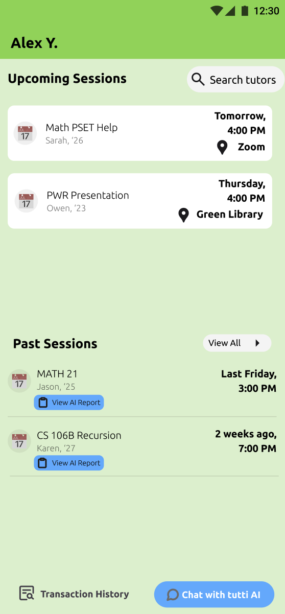
Home Page
Severity: 4
H5: Unable to edit or cancel scheduled session
H3: Need more noticeable “new session button”
H7: unclear that “Search tutors” leads to new session
H6: No indication of recurring session
H3: Unable to cancel recurring session button
H7: DM button not accessible

Slide 17
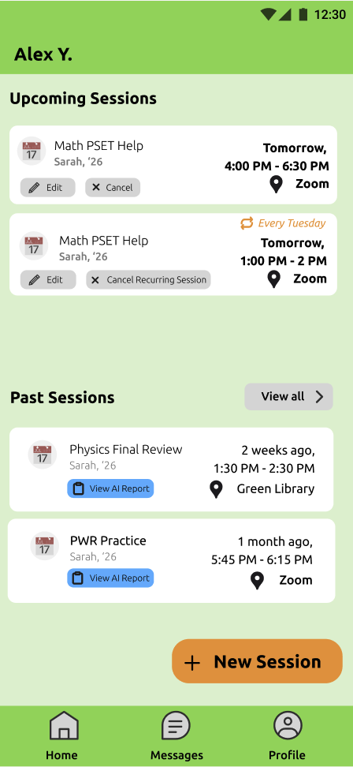
Revised Homepage
Fix:
Add edit/cancel session buttons
Accessible new session button
Clear navigation bar

Slide 18
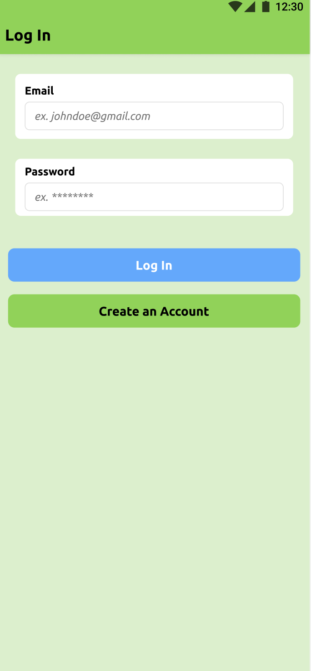
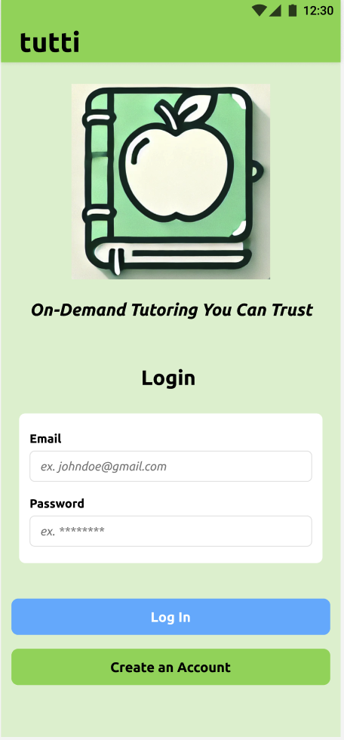
Login
Severity: 3
H2: Login page lacking information about the app
Fix:
Add tutti logo and app name on login
Include value proposition

Slide 19
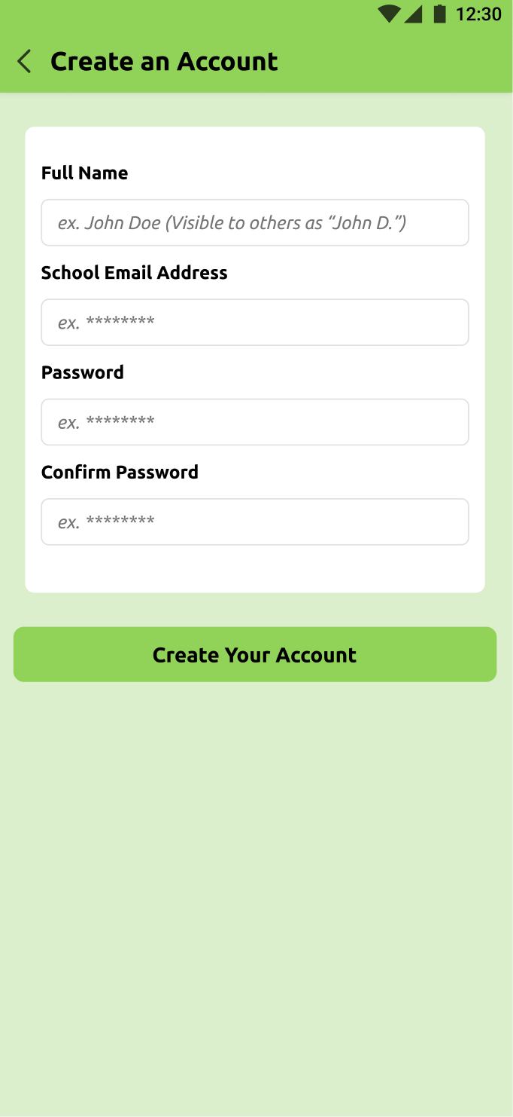
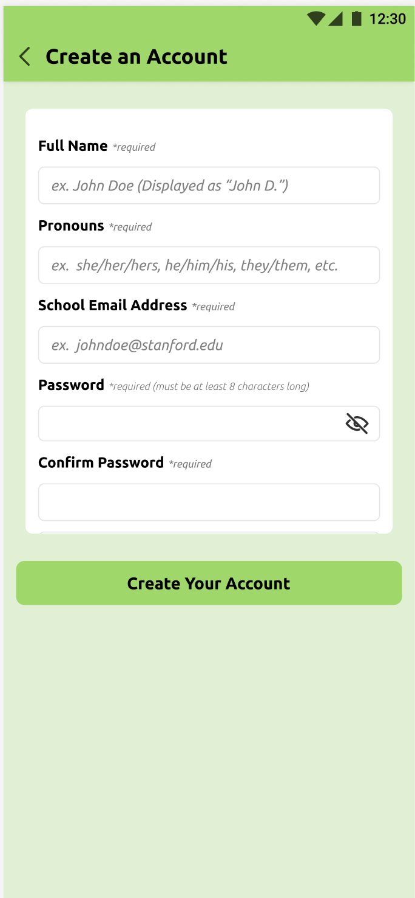
Create an Account
Severity: 3
H3: Missing information for valid inputs and required fields
H12: Lacking pronouns for inclusivity
Fix:
Add pronoun field
Indicate required fields
Add visibility button for password privacy

Slide 20
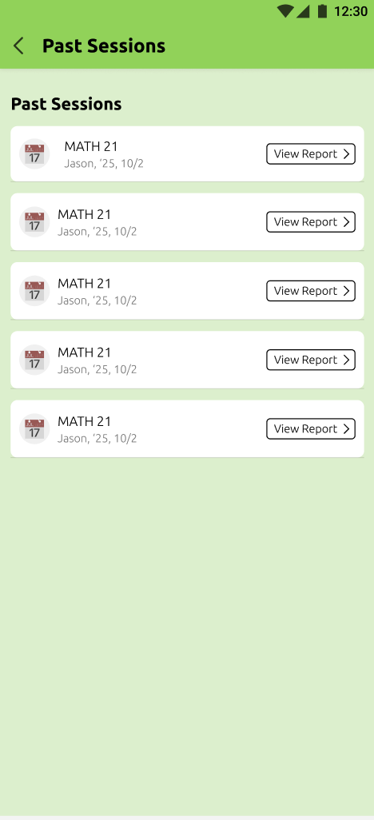
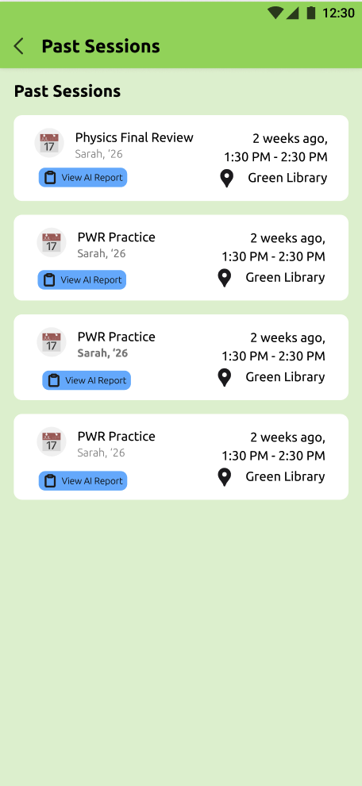
Past Sessions:
Severity: 4
H4: Inconsistent button design
H6: Past session list last session information

Slide 21
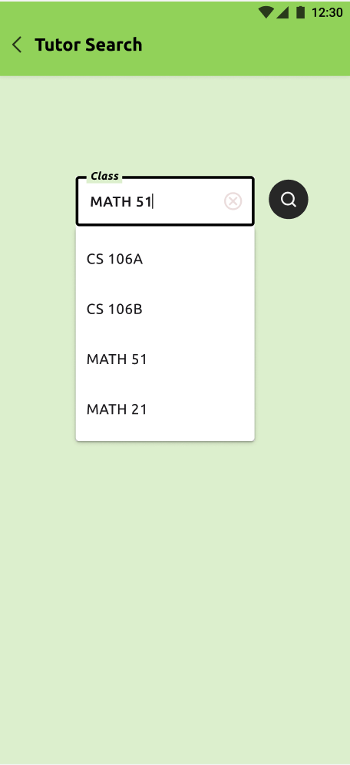
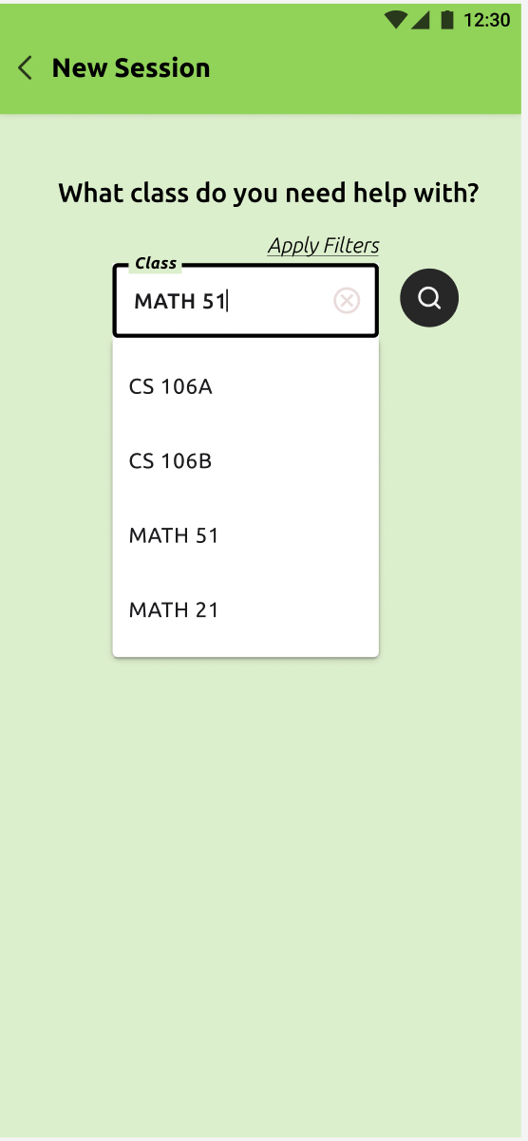
New Session Request
Severity: 3
H5: Lack input validation for session request
H7: No filtering option -> less efficient
Fix:
Add “Apply Filter” button for more personalized results
Guiding question on what to search
Reworded page title for clarity

Slide 22
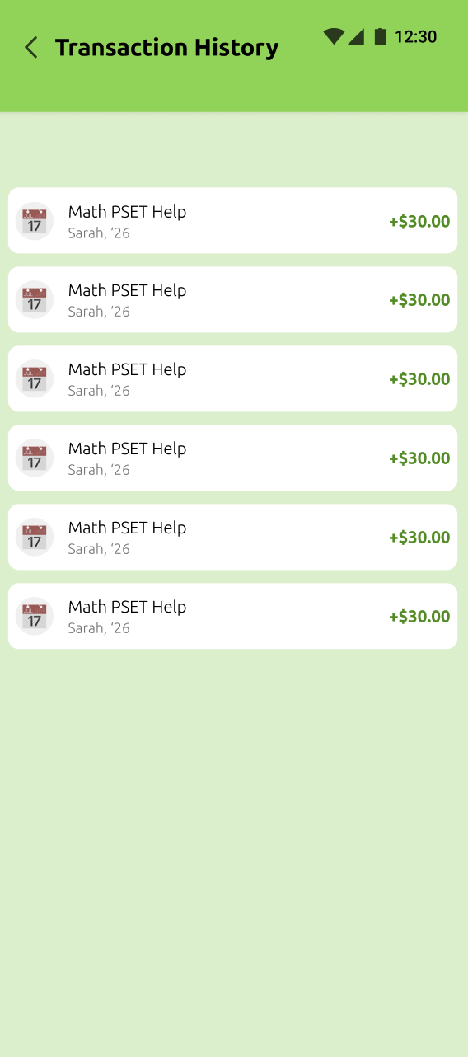
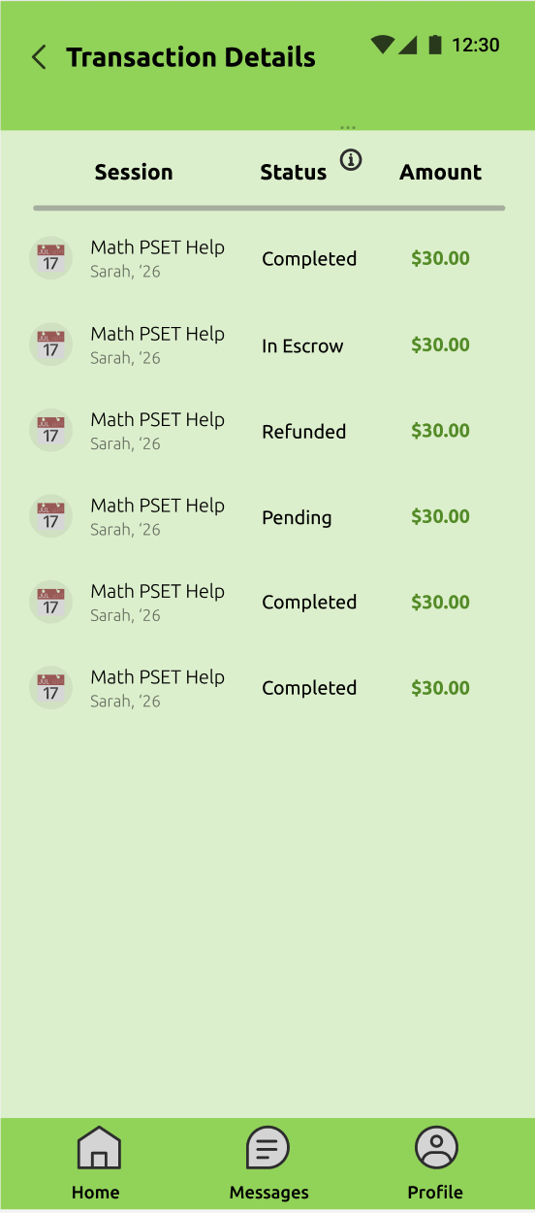
Transaction Details
Severity: 4
H1: No indicator for payment state
Fix:
Organized transaction details
Clear display of transaction state
Add info button on status meaning

Slide 23
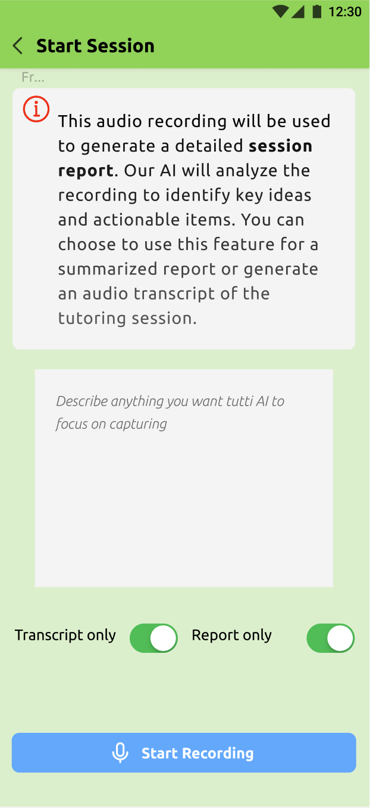
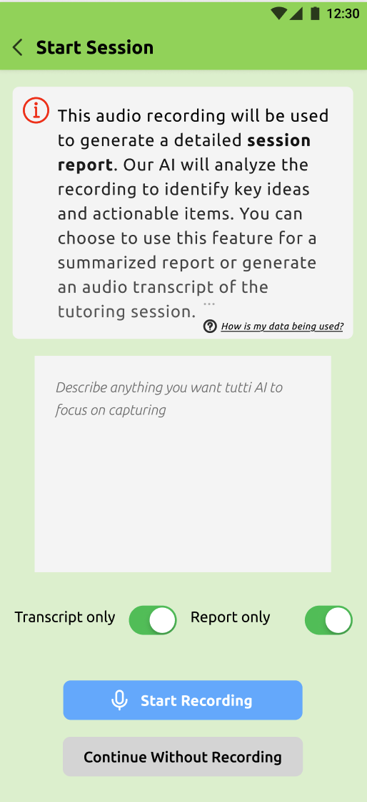
Recording Session
Severity: 4
H3: No option to skip recording
Severity: 3
H12: No privacy policy
Fix:
Add info button on data privacy
Add button to allow user to skip recording

Slide 24
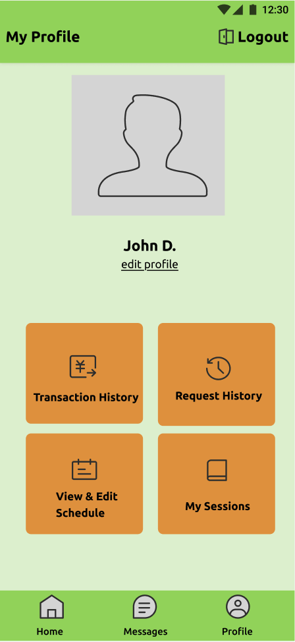
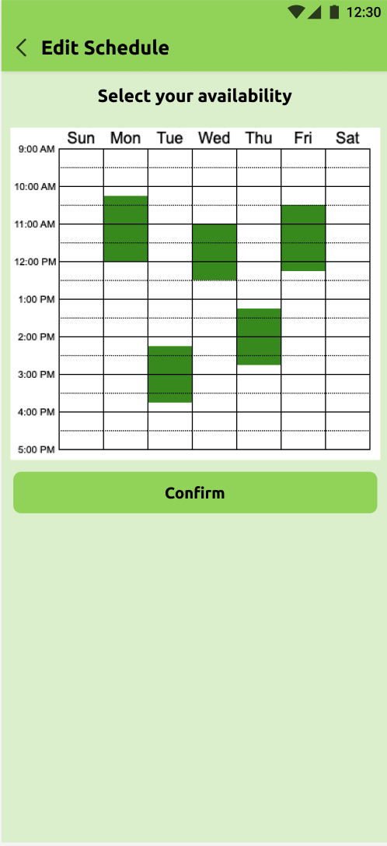
My Profile
Severity: 4
H1: Unable to see current schedule or change it
Severity: 3
H3: Missing logout function
H7: Unable to view past requests
Fix:
New profile page
Buttons to easily access user information

Slide 25
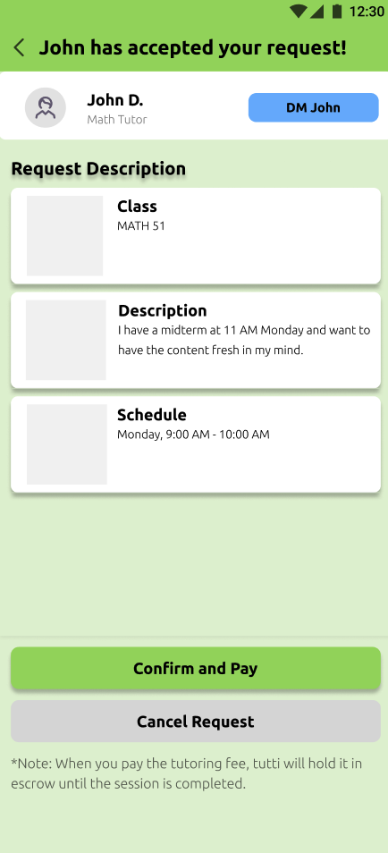
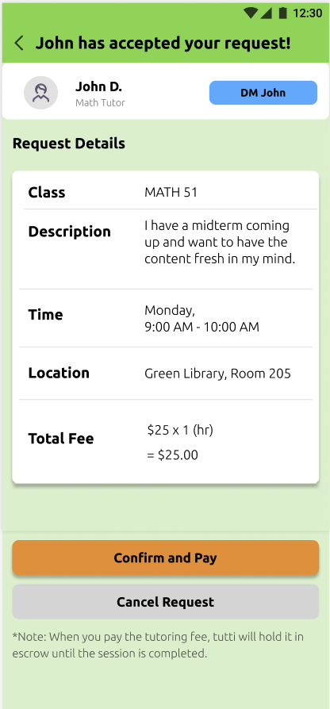
Session Confirmation
Severity: 4
H1: Description does not include session location
Severity: 3
H6: Unable to recall fee and payment
Fix:
Reorganized request description
Clear display of tutor fee and location
Adjusted button color for branding

Slide 26
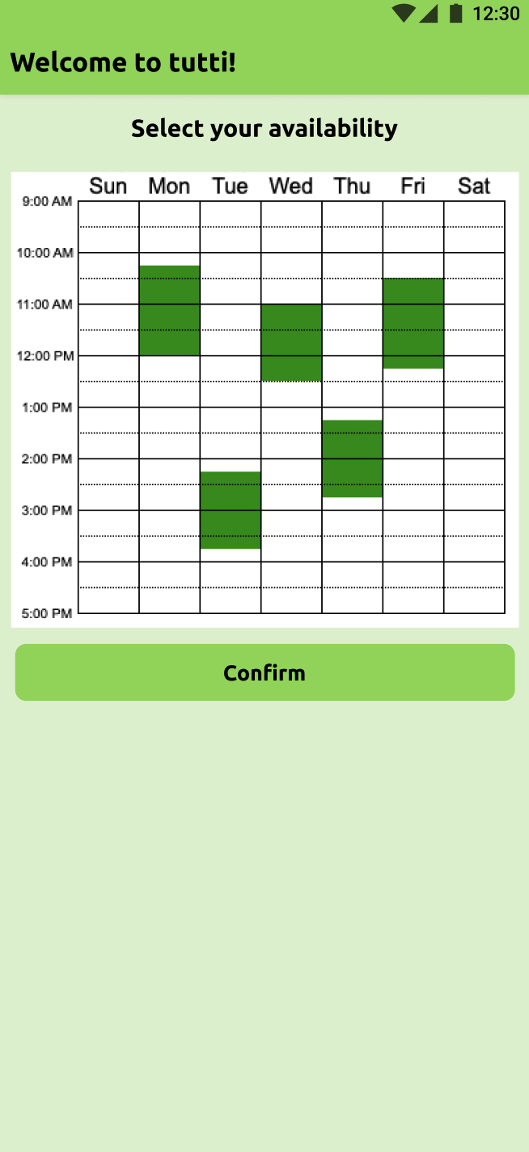
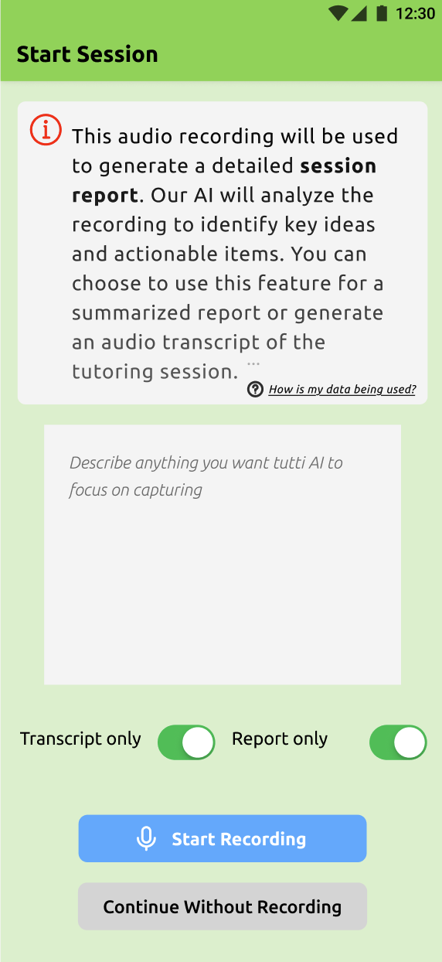
Back Buttons
Severity: 3
H5: Users are able to go back and potentially pay twice
H5: Not intuitive to go back after creating account
Fix:
Remove unnecessary back buttons to avoid confusion and unintended actions

Slide 27
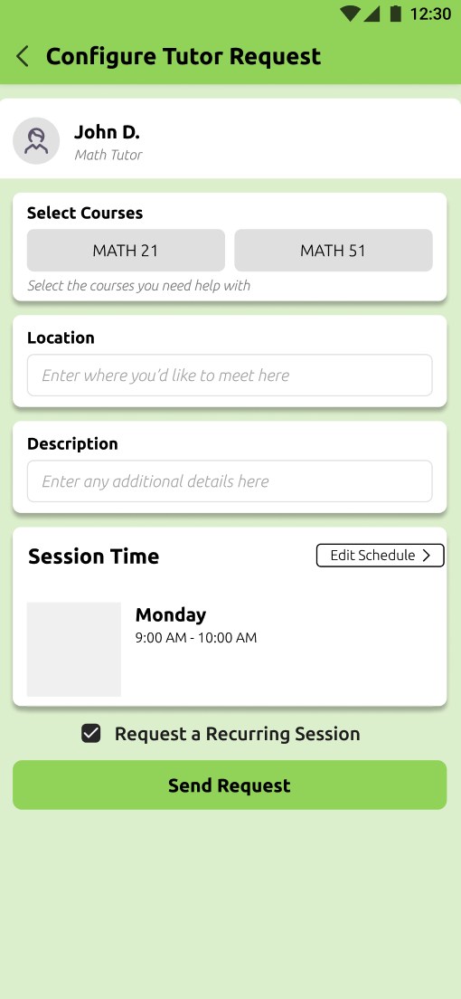
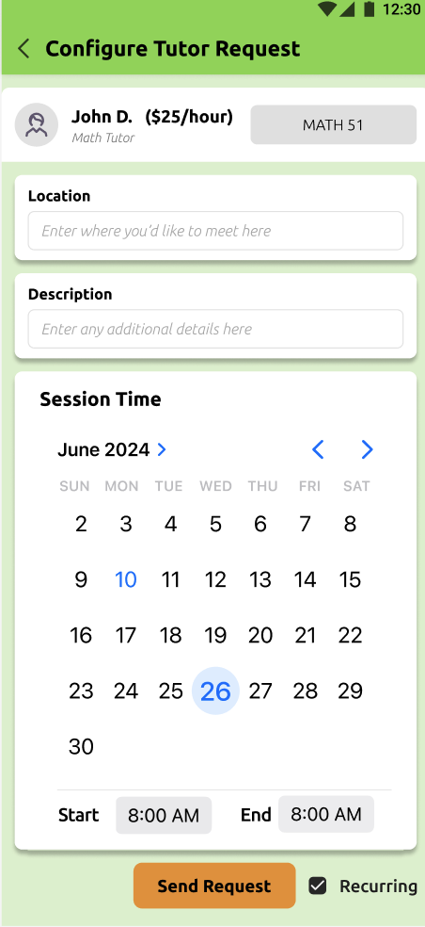
Some additional changes!

Slide 28
Usability Goals Progress
Usability Goals
Hifi Improvements
Make the app an enjoyable experience
Adjusted color scheme and reorganized information to be easily recognizable
Allow users to perform tasks quickly with minimal effort.
Created new buttons and more intuitive paths to accomplish common user tasks
Protect users and their data at all times
Allow users to opt-out of privacy-sensitive tools and provide clarity on how data is being used

Slide 29

Tools:
React Native (application
framework)
Expo (building and
simulation)
Visual Studio Code (IDE)
Figma (for design
components)
GitHub (collaboration)
Additional resources (reactnative.dev)

Slide 30

Hard Coded Features
Tutor Profile Information
Upcoming/Past Session Details (date, time, location)
Class Search + Tutor Search Results (student reviews, ratings, etc.)

Slide 31
Implemented Features
User Account Management
Log in and sign-up functionalities are operational.
Profile setup, including bio and schedule
Home Page
Tutor profile information display.
Upcoming and past session details (date, time, location).
Class and tutor search results with ratings and reviews.
Session Requests
Users can request new tutoring sessions with initial setup.
Search by class and see available tutors
Calendar Integration and Session Creation
Set up and manage your availability
Set your rate and class you would like to tutor

Slide 32
Task Flow 1:
Request a Tutoring Session

Slide 33
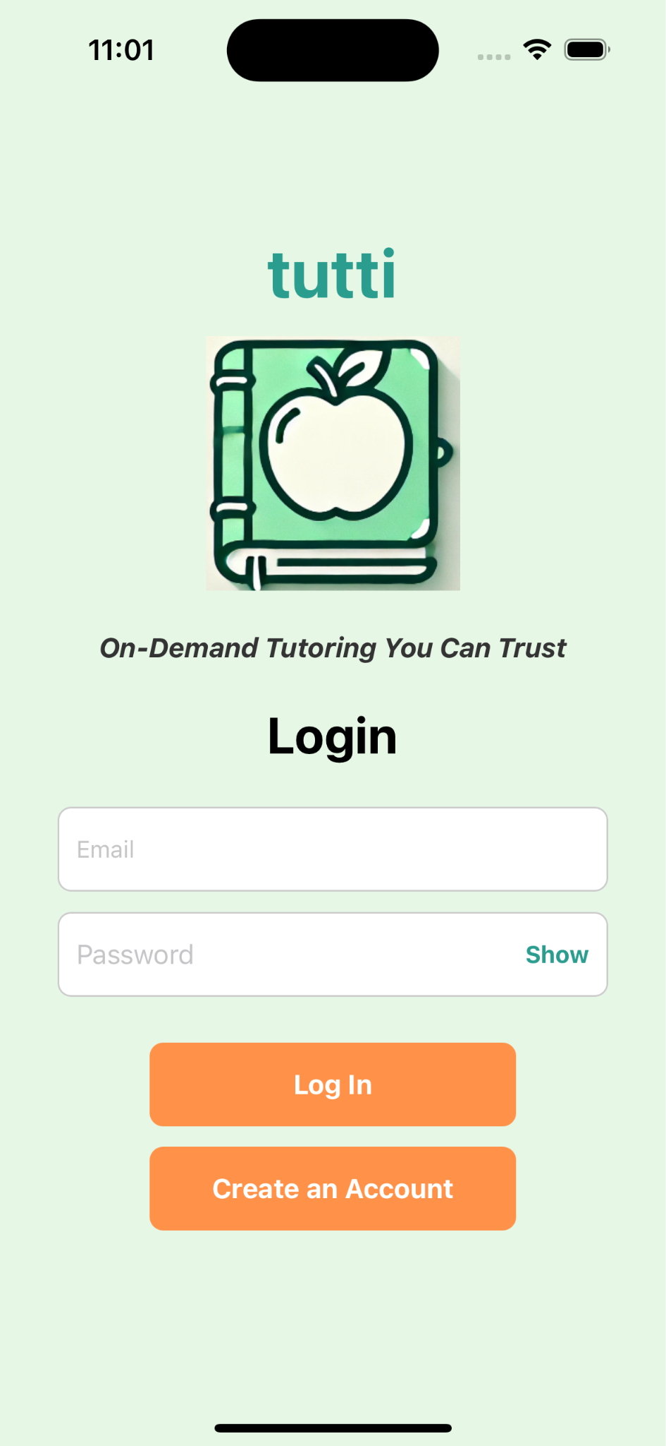
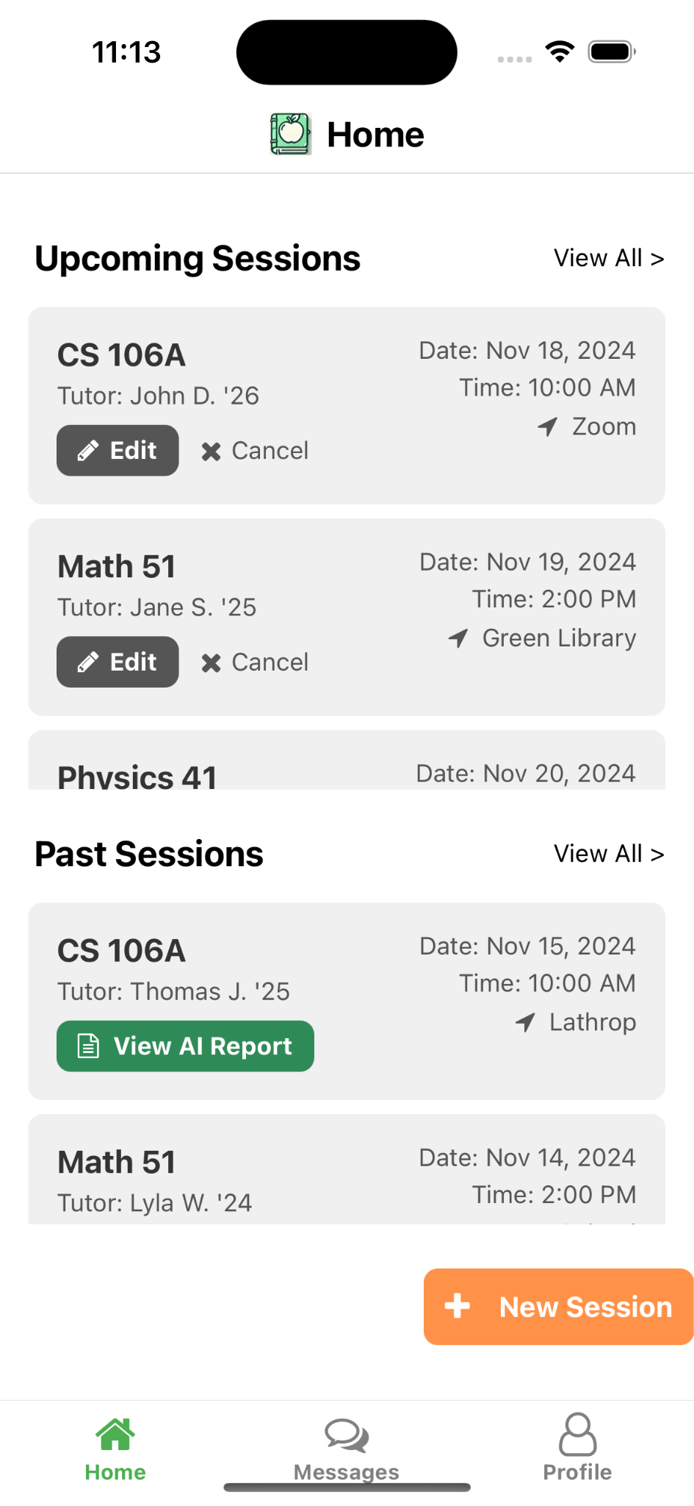


Slide 34
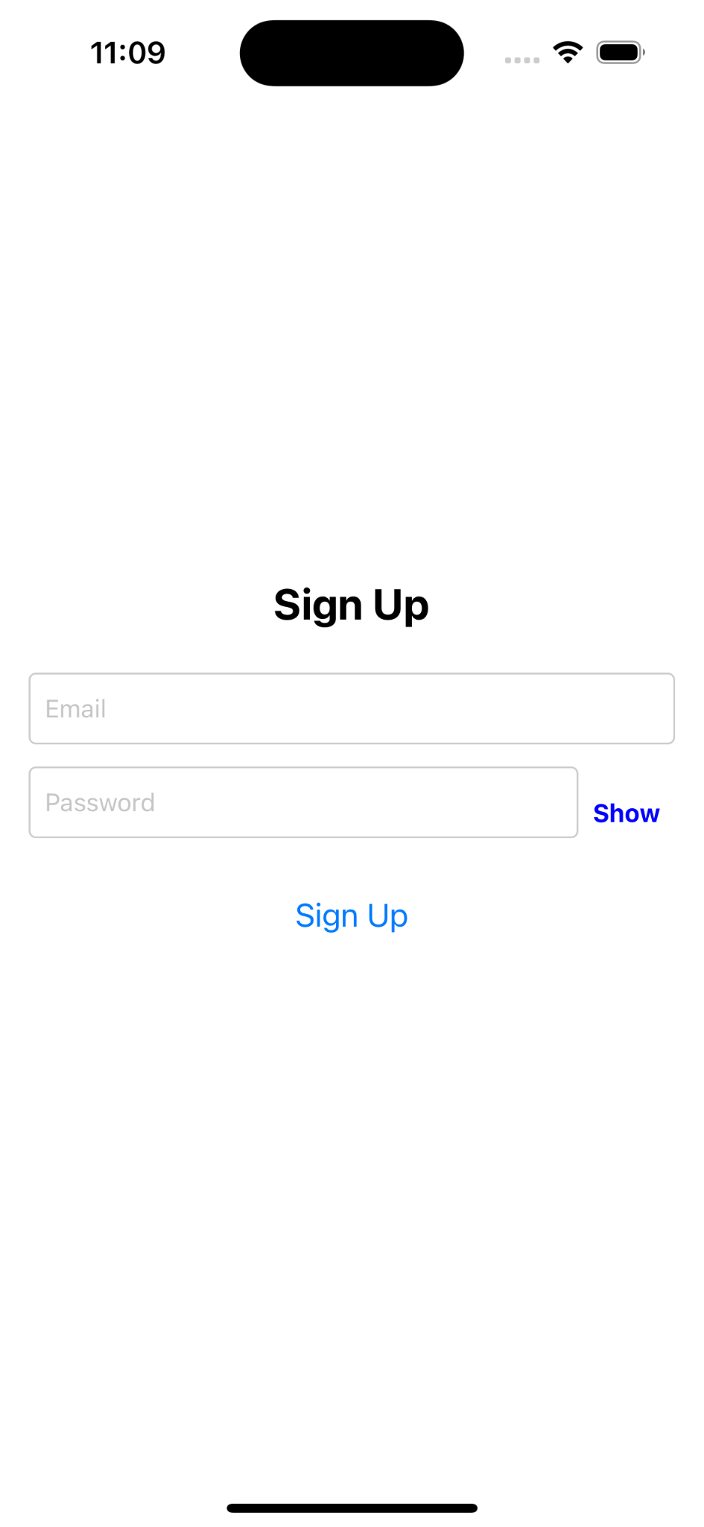
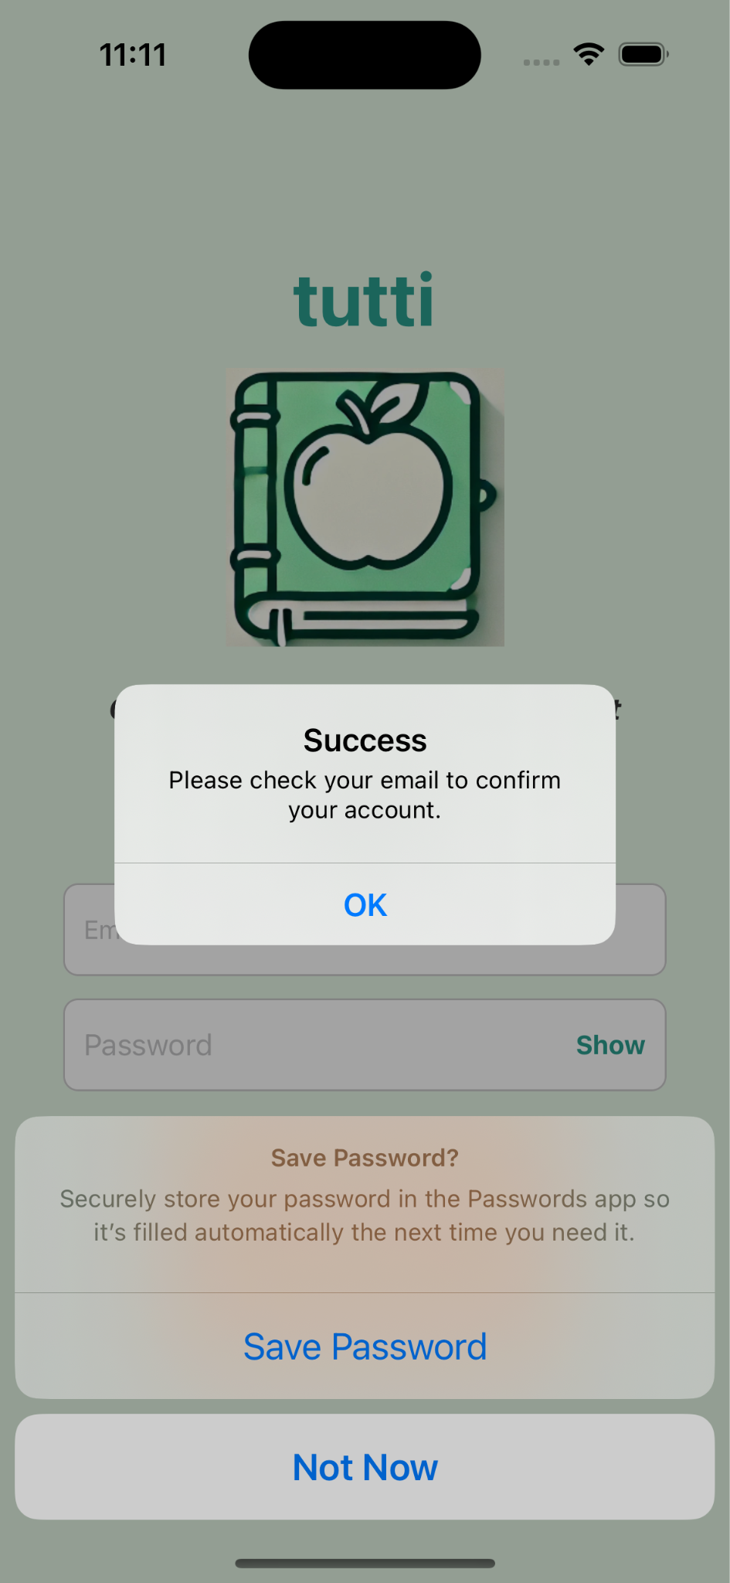
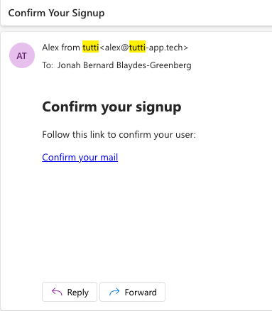

Slide 35

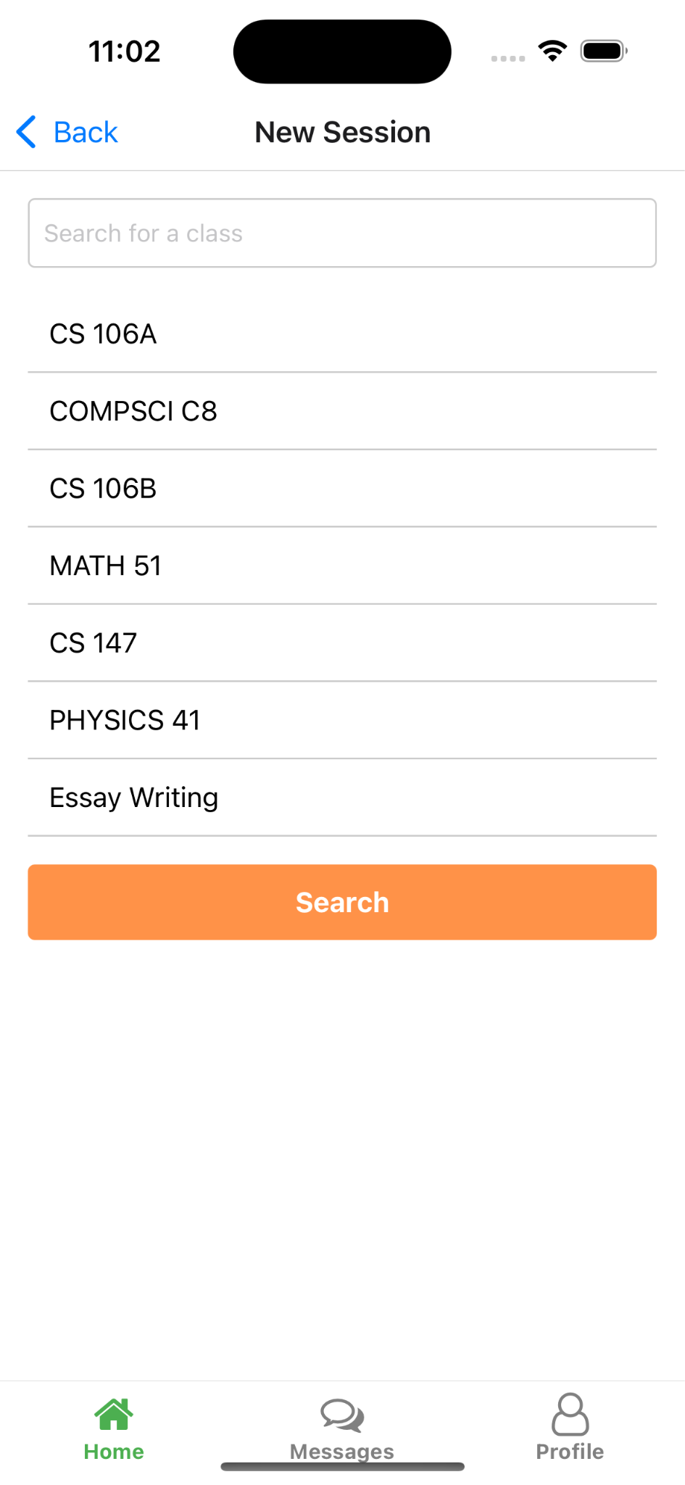


Slide 36
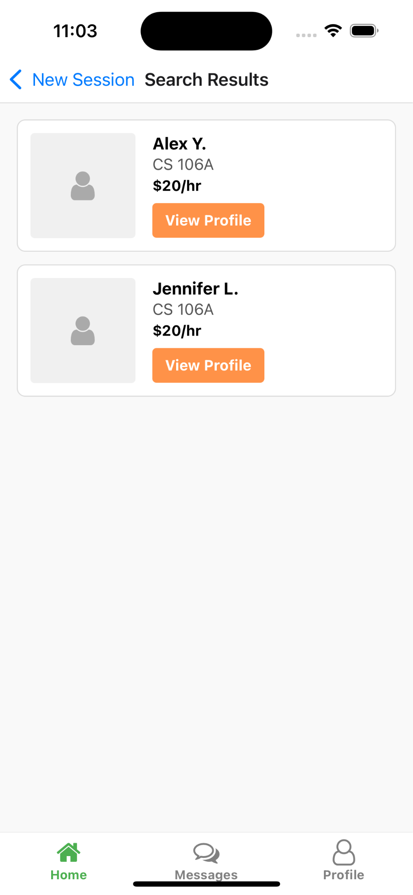
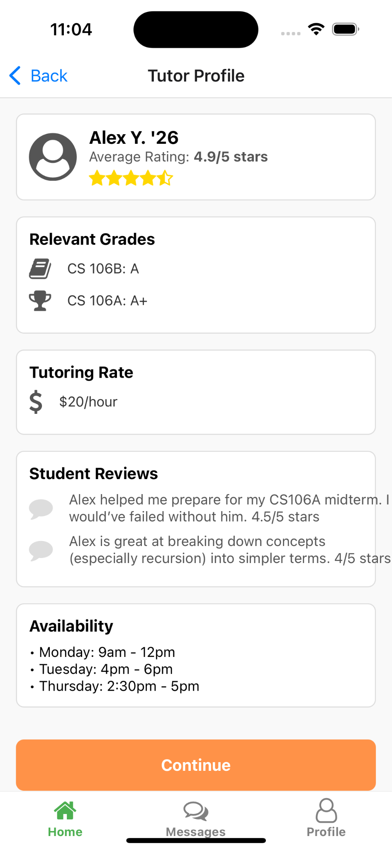
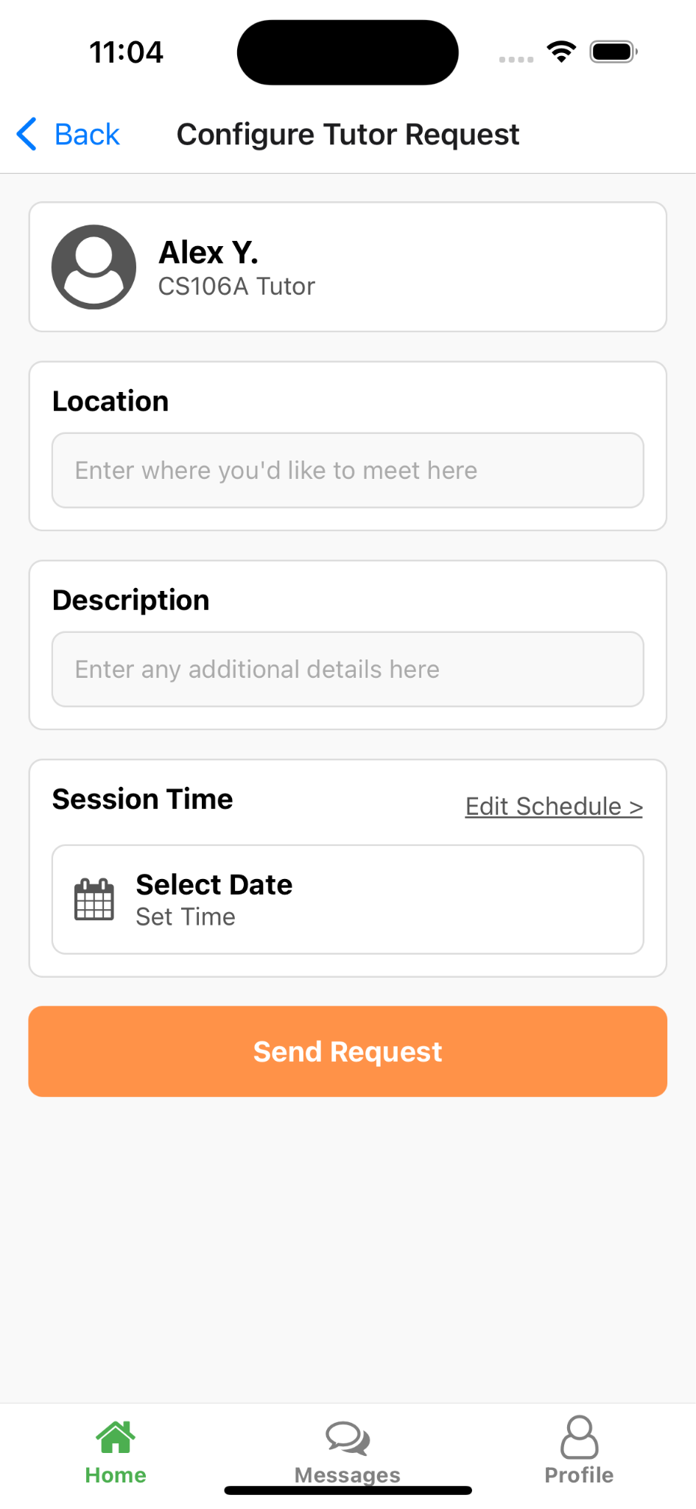

Slide 37
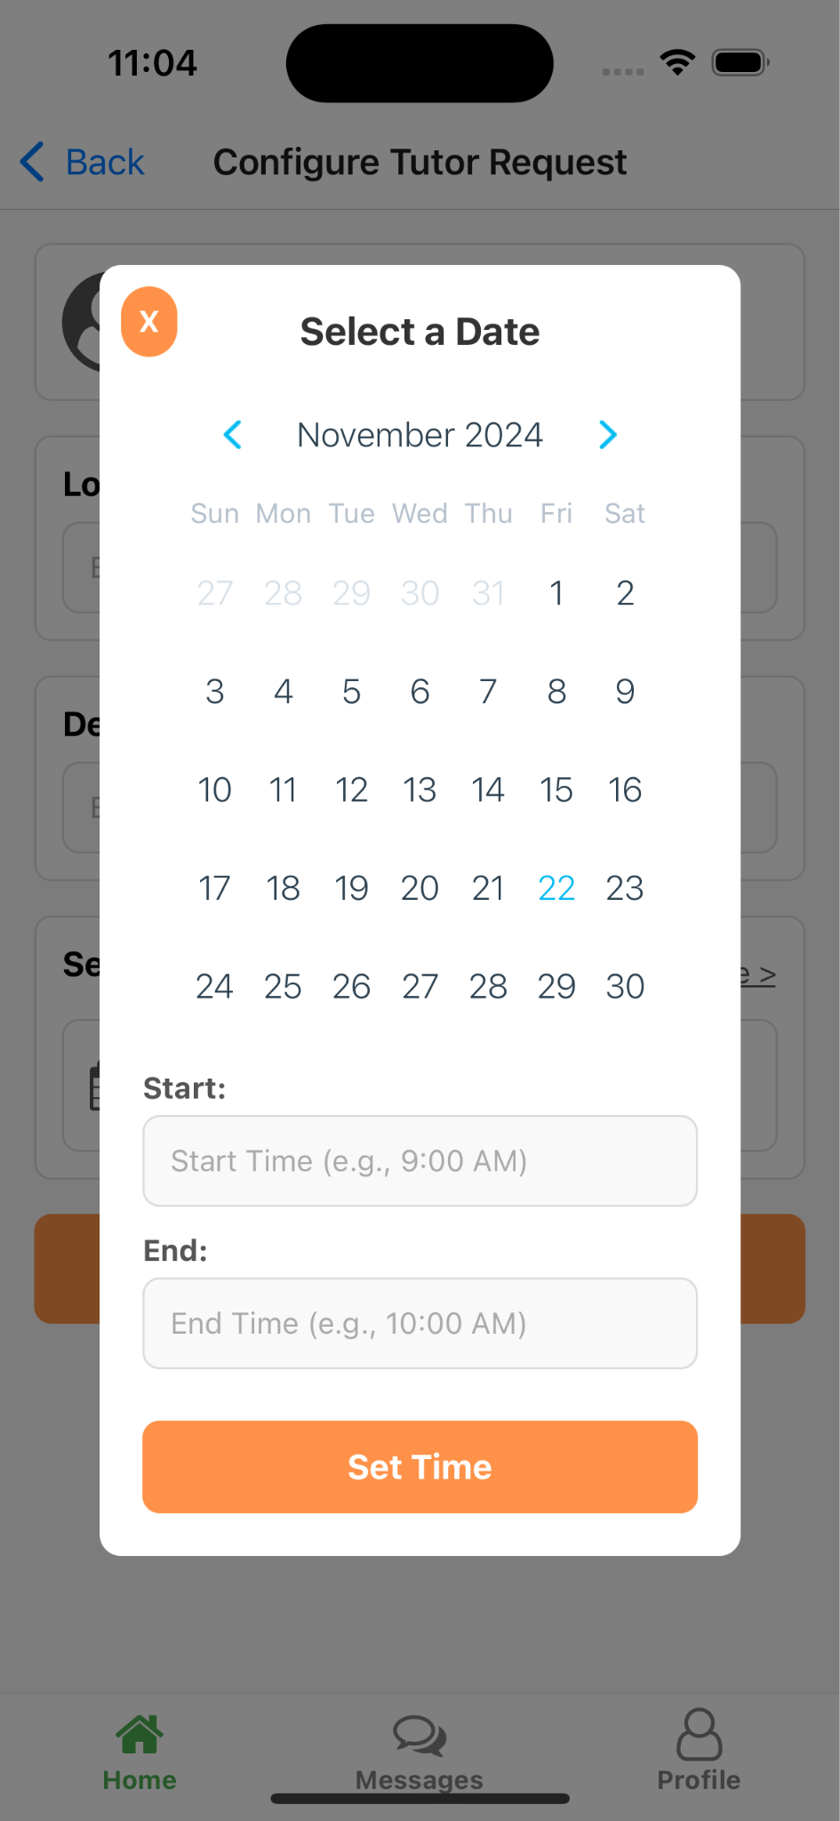
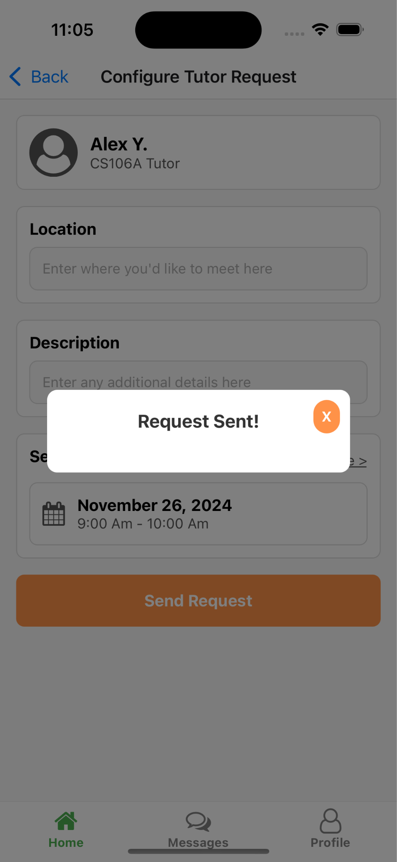

Slide 38
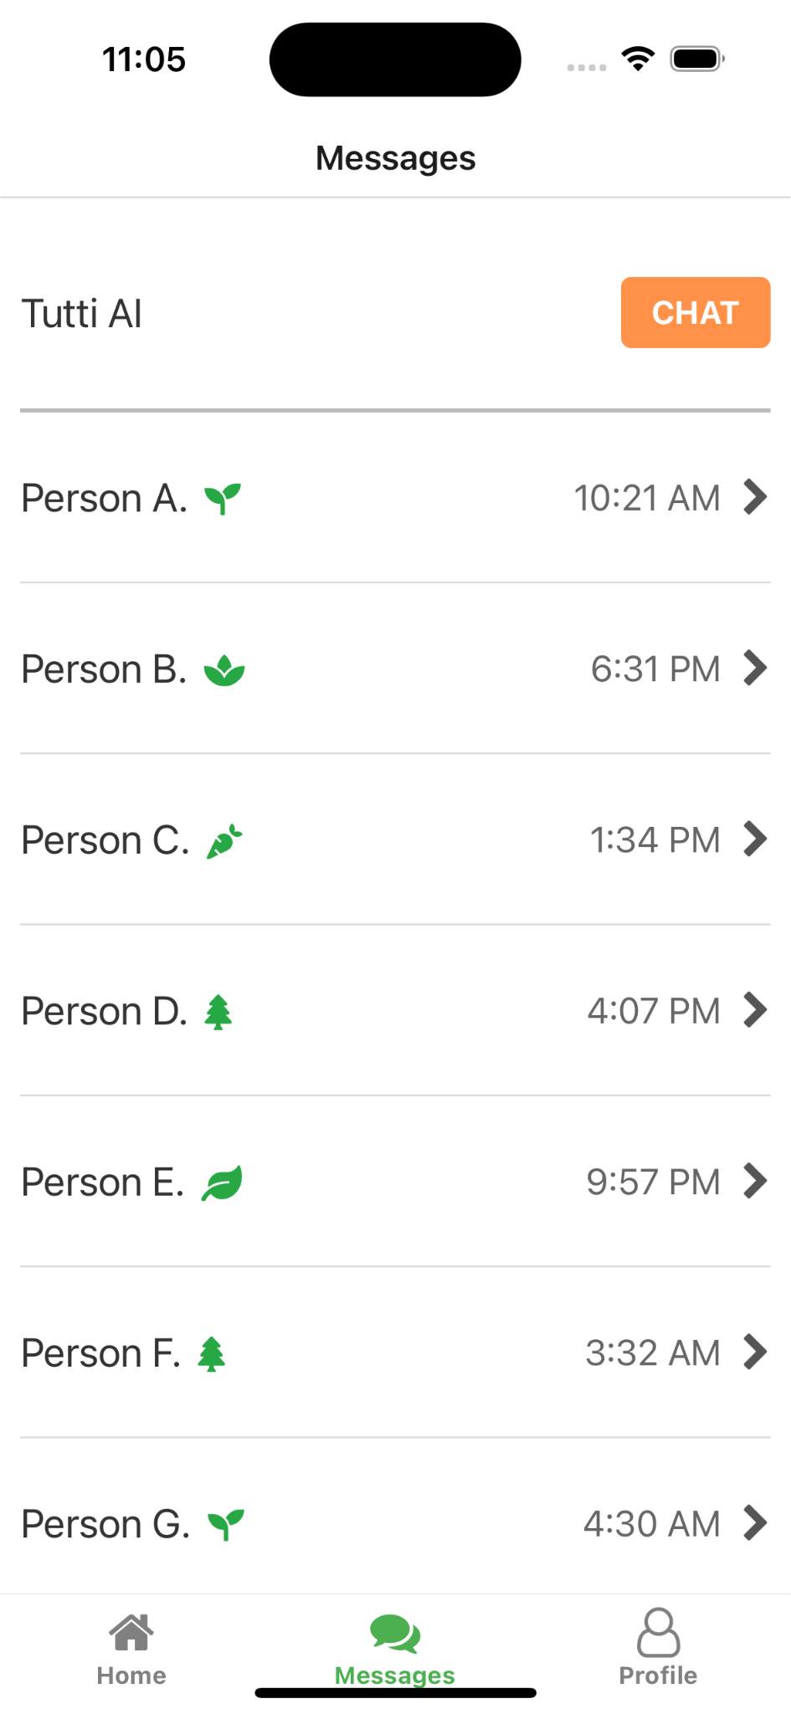
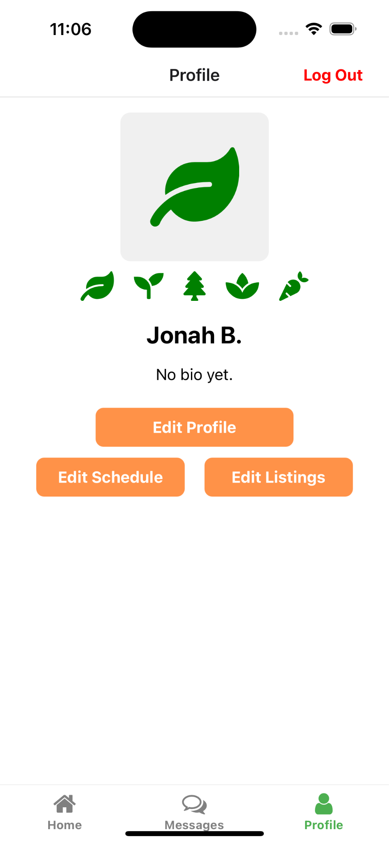

Slide 39
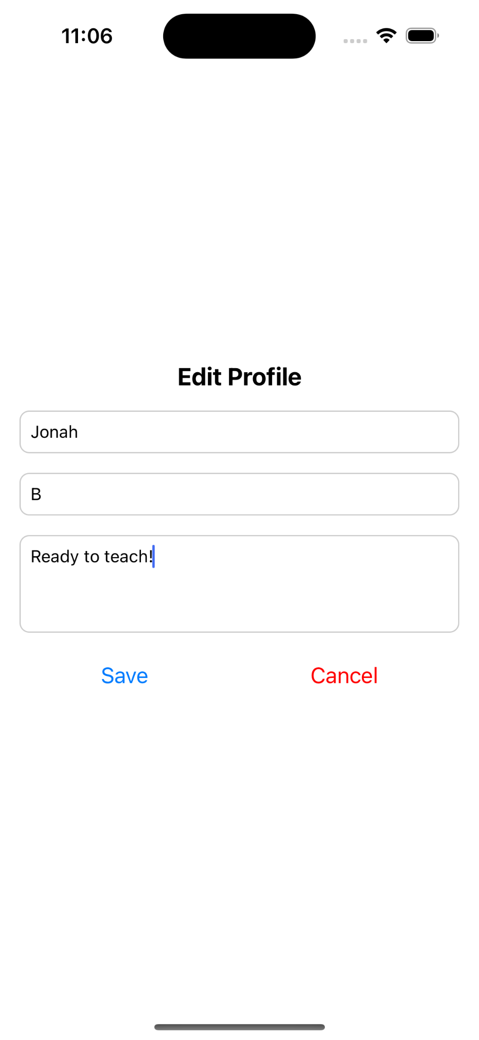
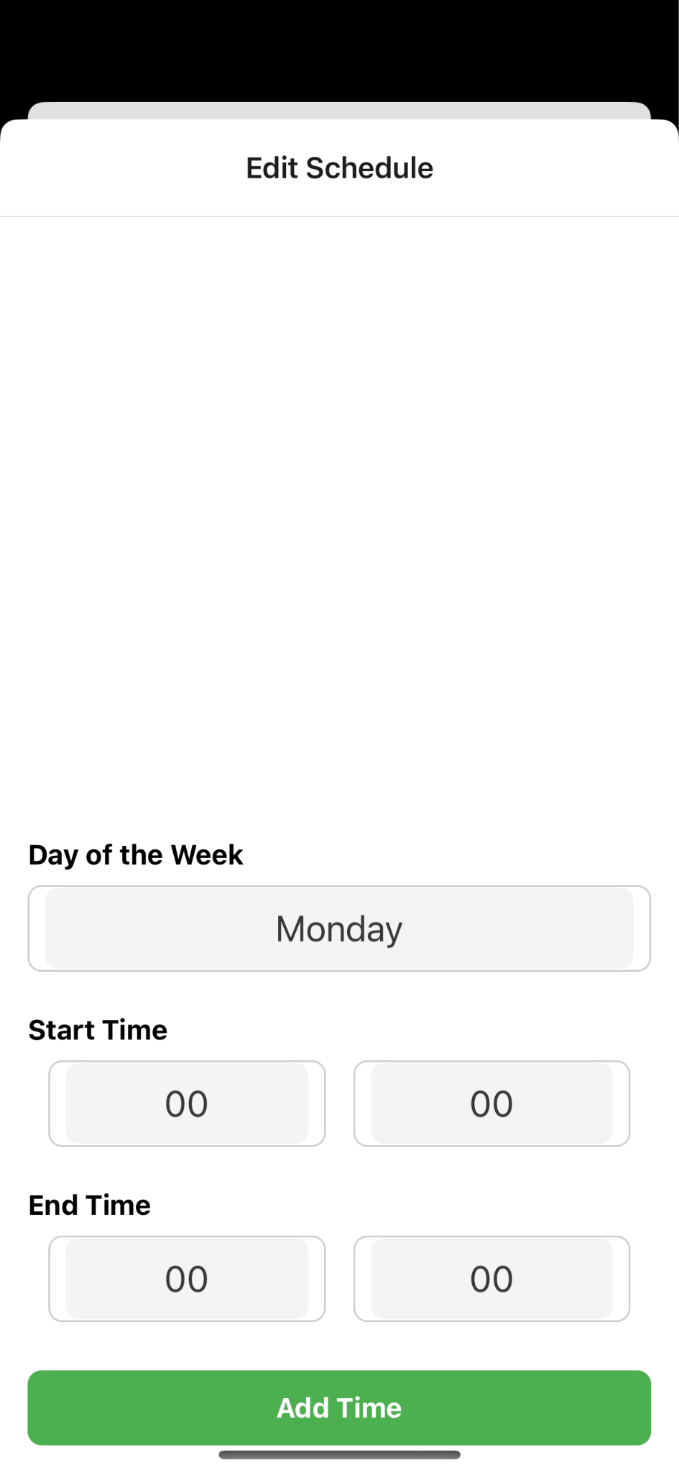

Slide 40
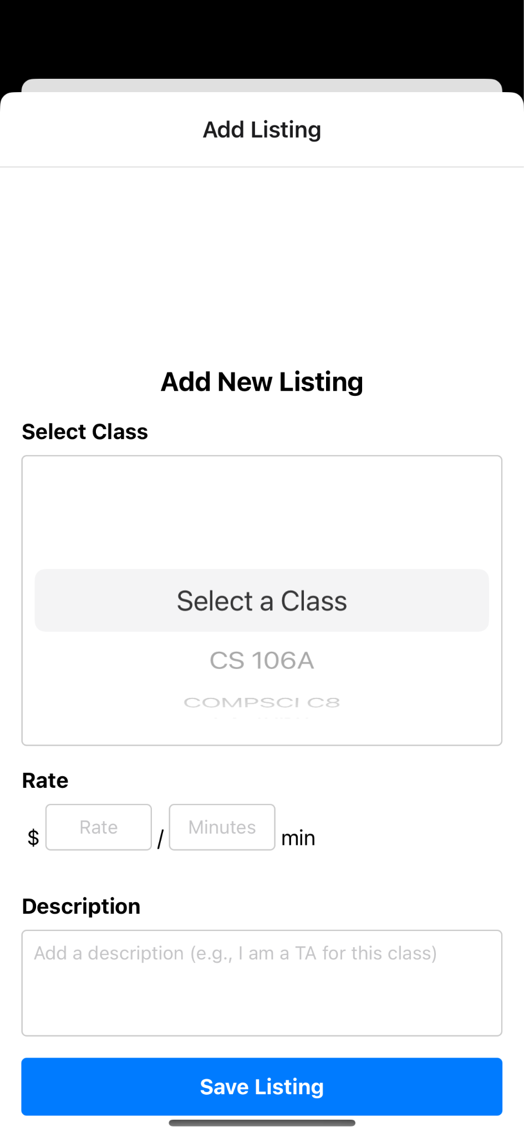
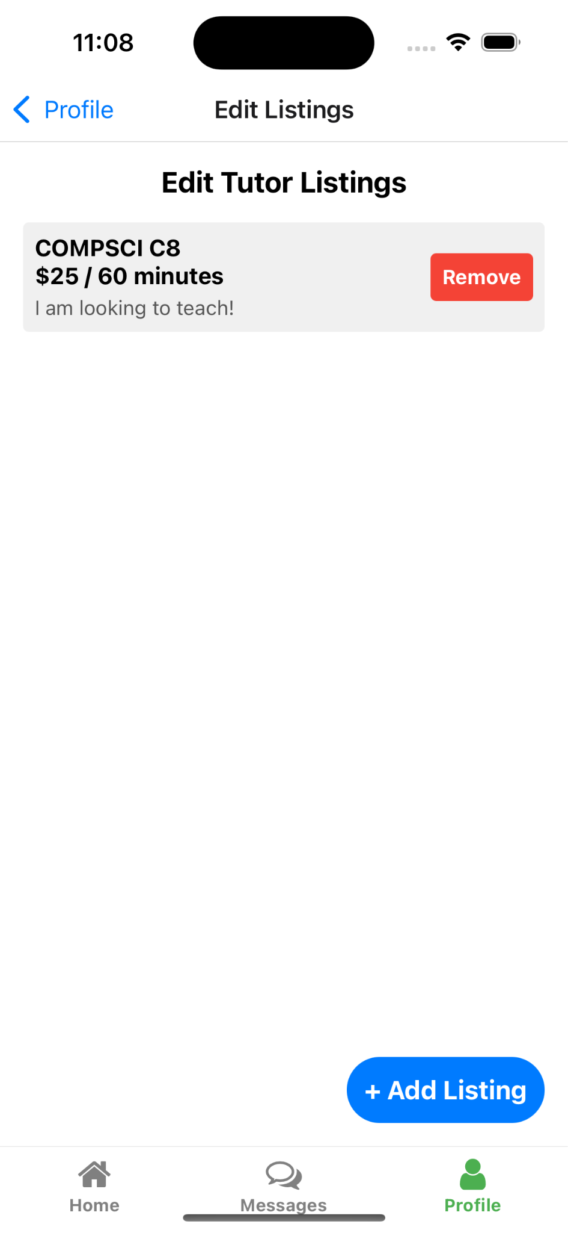

Slide 41
Unimplemented Features
Integration and Advanced Functionality
Integration between students requesting sessions and tutors receiving requests
Ability to start a session without recording
Filtering options for session requests.
Indicators for recurring sessions
Communication Tools
Chat functionality between students and tutors.
Chat functionality with the AI
Session Management
Editing or canceling upcoming sessions via a home bar calendar
Adding tags to mark recurring sessions
AI-Driven Features
Viewing AI-generated tutoring reports.
AI Chat bot

Slide 42
Plan for finishing
Prioritize High-Impact Features
Editing and canceling upcoming sessions.
Adding a new home bar calendar view to manage availability.
Implementing filters for session requests.
Enhance Communication
Add chat and DM functionality
Add notifications for when you receive a session request as a tutor
Add pop up notifications for when you receive a message
Complete AI Integration
Build and integrate the AI report-viewing feature.
Ensure reports provide value alignment and inclusivity, as highlighted in heuristic evaluation.
Ensure Accessibility and Privacy
Implement privacy options (e.g., AI usage, option to skip recording).
Add inclusive design elements, such as a pronoun field in the signup process.

Slide 43
Demo

